Slide 1



E-Commerce Website
October 2026
Architecting Platforms.
Delivering Trusted Insight.
Enabling Intelligence.
Decision Intelligence, Reporting & Data Platforms
1

Slide 2


Contents
1
XXX
6
2
XXX
9
XXX
3
11
4
XXX
13
5
XXX
16
6
XXX
19
DECISION INTELLIGENCE, REPORTING & DATA PLATFORMS
7
XXX
22
8
XXX
24

Slide 3

Overview
You are an ambitious individual looking to start up an e-commerce business called Tech Traders specializing in electronics and gadgets, but you don’t know how the first thing about development, so you hire me to pitch a potential solution with a demo application. Your demands are straightforward – “Just impress me”. So, this is what I would consider.
Considerations:
API based application – for modularity.
UI built on React.js framework – for modern and responsive user experience.
MVC architecture - for easy maintenance.

Slide 4
Overview
The applications core functionality involves basic e-commerce functions user authentication, product handling like searching products, exploring products and adding products to a cart. Clicking on a product allows users to inspect the product on a dedicated product page where they can also see other items in the same category, prices from other companies and YouTube reviews. Carts will turn into orders upon ‘/checkout’ and these orders will be linked to user accounts. Users can register as either an employee or a customer through either the employee site or the customer site. After a customer has checked out, they will receive an order confirmation through e-mail. They will also be able to monitor their order status.
Considerations:
API based application – for modularity.
UI built on React.js framework – for modern and responsive user experience.
MVC architecture - for easy maintenance.

Slide 5
Features
The Application intends to be a simple non-sophisticated alternative to larger corporations out there like Takealot and Amazon. The Tech Traders e-commerce application features these components:
Essential components:
User authentication and account handling
Product handling
Order handling
Admin and Management
Payment handling
Device scaling
Non-essential components:
Endpoint performance tracking in ELK stack
AI product price comparison web search
AI YouTube review web search
Cloudinary blob storage

Slide 6
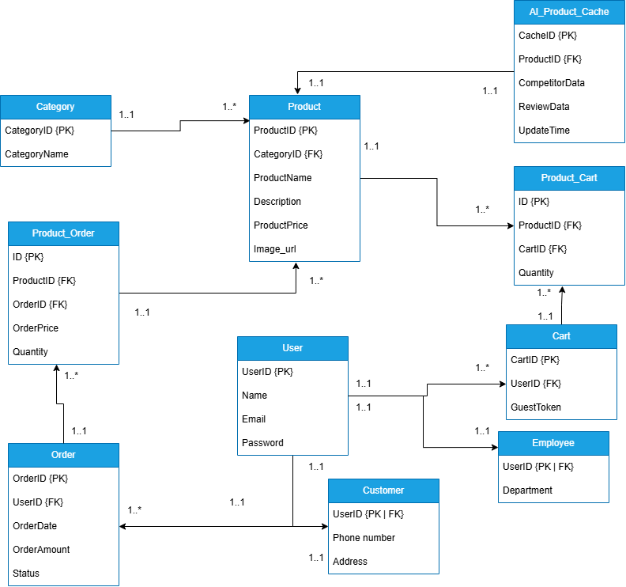
Database Schema

Slide 7




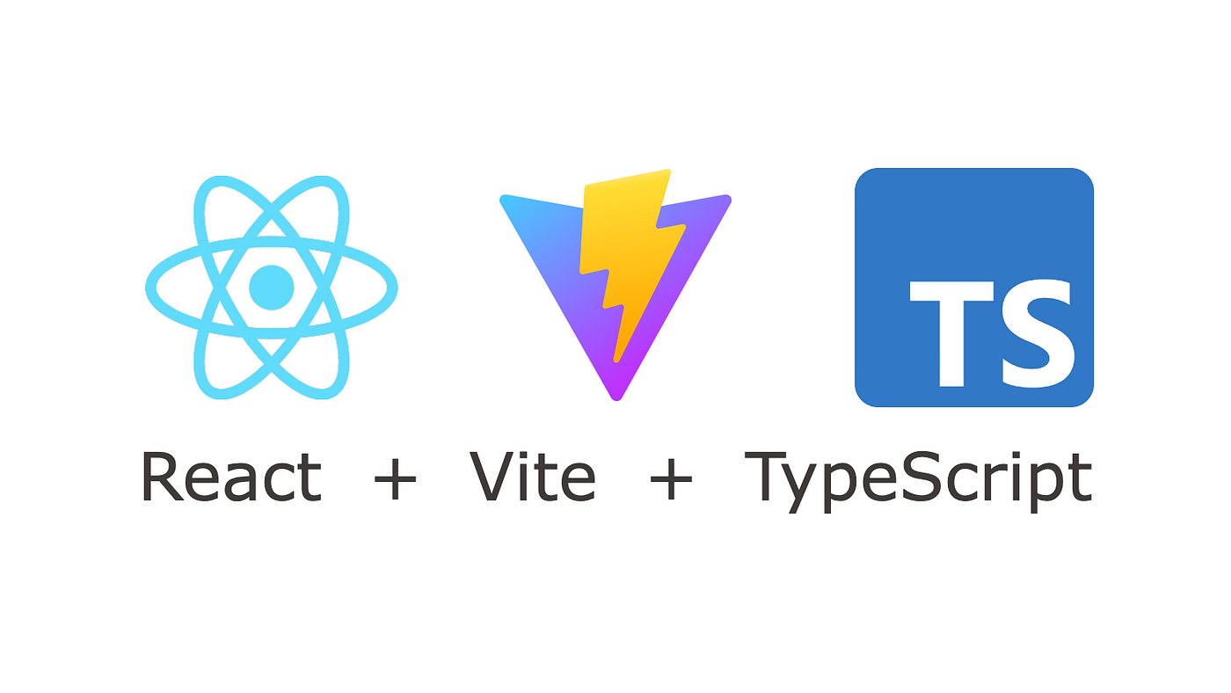





Architecture
ELK stack for monitoring and observability
Data moves between database and Flask app using SQLAlchemy
Frontend sends images to be stored as a blob on the cloud and returns a URL which gets stored in the database
Data flows between app and client through endpoint calls, but this client is used for testing endpoints with JSON body
Data flows between each app through endpoint calls
Resend for automated email passing an html body
Tivaly web-search AI agent for search results to be passed to a JSON body to the frontend
stripe API returns a payment intent to allow /checkout

Slide 8

Thank You
Shaila Jivan – Group Managing Director
Sambe Consulting
082 416 0579
shaila.jivan@sambeconsulting.com
info@sambe.co.za
www.sambe.co.za
1 Maxwell Drive, Woodmead, Sandton, 2191
Decision Intelligence, Reporting & Data Platforms
8
8

